Slide 1
Entity-Relationship Model
Using High-Level Conceptual Data Models for Database Design
Entity Types, Sets, Attributes and Keys
Relationship Types, Sets, Roles and Constraints
ER Diagrams, Naming and Design Issues
Mapping Constraints
Keys
E-R Diagram
Extended E-R Features
Design of an E-R Database Schema
Reduction of an E-R Schema to Tables

Slide 2
Using High-Level Conceptual Data Models for Database Design
Requirements collection and analysis
  DB designer interview user to understand and document their data requirements
  Result: concisely written set of users’ requirements
Functional requirements
  user-defined operations applied to the database (retrievals and updates)
  Operations defined using data flow diagrams, sequence diagrams, or scenarios
conceptual design
  create a conceptual schema using a high-level conceptual data model

Slide 3
Using High-Level Conceptual Data Models for Database Design…..
  CS:concise description of the data requirements of the users and includes detailed descriptions of the entity types, relationships, and constraints
  These req. do not include implementation details. (reference)
Actual implementation using a commercial DBMS
  Logical Design:the transformation of conceptual schema from the high-level data model into the implementation data model (DB schema)
  Physical design
  internal storage structures, access paths, and file organizations for the database files are specified
  in parallel application programs are designed and implemented.

Slide 4
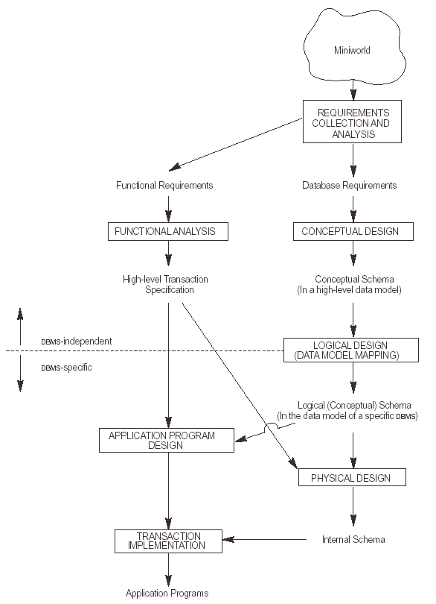

Slide 5
Entity Types, Sets, Attributes and Keys
A database can be modeled as:
  A collection of entities,
  Relationship among entities.
An entity is an object in real world with an independent existence.
  Object with a physical existence (Person, employee)
  object with a conceptual existence (company, dept)
Entities have attributes
  Example: people have names and addresses

Slide 6
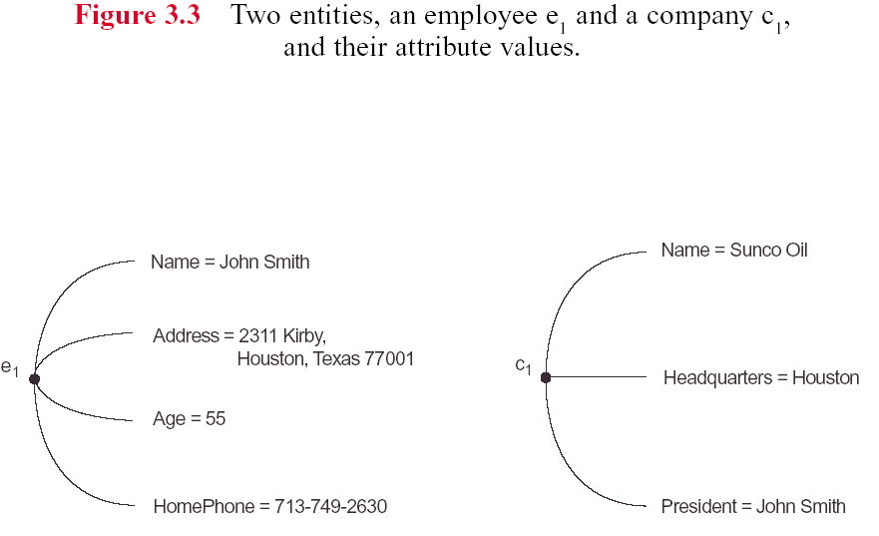

Slide 7
Entity Types, Sets, Attributes and Keys…..
Attribute types:
  Simple and composite attributes.
    E.g. Address attribute (could forms hierarchy)
  Single-valued and multi-valued (set of values for the same entity) attributes
    E.g. multivalued attribute: phone-numbers, college degrees, car color
  Stored and Derived attributes
    Can be computed from other attributes
    E.g. age, given date of birth
  Null Values
    If we don’t know the value of an attribute for a particular entity (not applicable or unknown:missing or not known)
  Complex (nested) Attributes
    E.g. {AddressPhone({phone(areacode,phonenumber)}, address(streetadress(streetno,street,aptno),city,state,zip))}

Slide 8
Entity Types, Sets, Attributes and Keys…..
An entity type defines the collection of entities that have the same attributes.
An entity set is a set of entities of the same type that share the same properties at any point in time.
  Example: set of all persons, companies, trees, holidays
An entity is represented by a set of attributes, that is descriptive properties possessed by all members of an entity set.
  Example: customer = (customer-id, customer-name, customer-street, customer-city)
  loan = (loan-number, amount)
Domain – the set of permitted values for each attribute

Slide 9
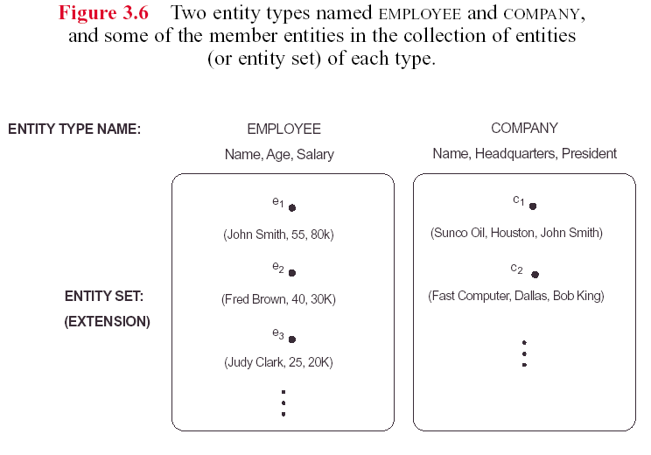

Slide 10
Entity Types, Sets, Attributes and Keys…..
Key Attributes of an Entity Type
  The key or uniqueness constraint on attributes is an important constraint on the entities of an entity type
  An entity type usually has an attribute whose values are distinct for each individual entity (KEY)
  Sometimes, several attributes together form a key, meaning that the combination of the attribute values must be distinct for each entity (must be minimal)
  In ER key attribute has its name underlined inside the oval
  An entity type may also have no key, in which case it is called a weak entity type

Slide 11
Entity Types, Sets, Attributes and Keys…..
Value Sets (Domains) of Attributes
  Each simple attribute of an entity type is associated with a value set (domain of values) (e.g. integer, float, string and length )
  Mathematically, an attribute A of entity type E whose value set is V can be defined as a function from E to the power set P(V) (set of all subsets) of V:
  A : E --> P(V)
  The value of attribute A for entity e is A(e).
  For a composite attribute A, the value set V is the Cartesian product of P(V₁), P(V₂), . . ., P(V_{n}), where V₁,V₂ , . . .,V_{n} are the value sets of the simple component attributes that form A:
  V=P(V₁) x P(V₂) x …P(V_{n})

Slide 12
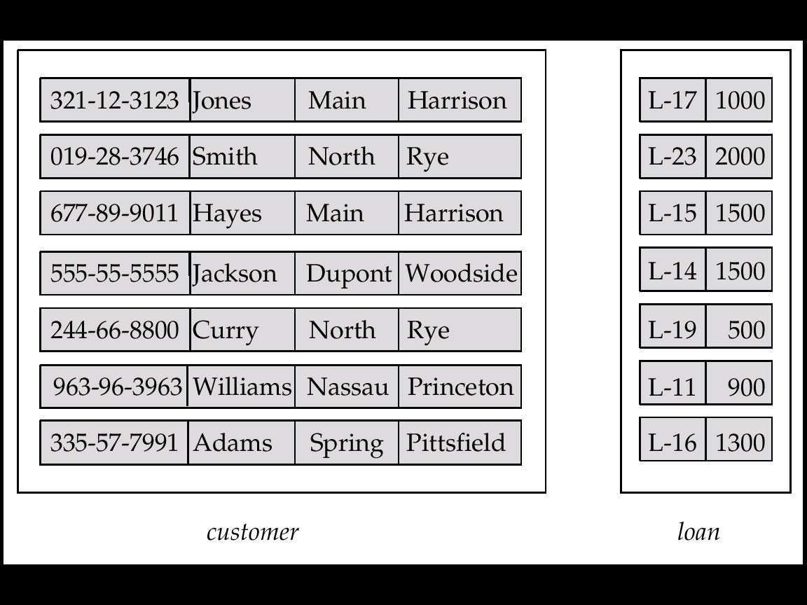
Entity Sets customer and loan
customer-id customer- customer- customer- loan- amount
name street city number

Slide 13
Relationship Types, Sets, Roles and Constraints
A relationship Type R is an association among several entities
  E.g.
  Hayes depositor A-102
  customer entity relationship set account entity
A relationship set is a mathematical relation among n ≥ 2 entities, each taken from entity sets
  { (e₁, e₂, … e_{n}) | e₁ ∈ E₁, e₂ ∈ E₂, …, e_{n} ∈ E_{n}}
  where (e₁, e₂, …, e_{n}) is a relationship r_{i}
  Example:
  (Hayes, A-102) ∈ depositor

Slide 14

Relationship Set borrower

Slide 15

Relationship Sets (Cont.)
  An attribute can also be property of a relationship set.
  For instance, the depositor relationship set between entity sets customer and account may have the attribute access-date

Slide 16
Degree of a Relationship Set
Refers to number of entity types that participate in a relationship set.
Relationship sets that involve two entity types are
  binary (or degree two). Generally, most relationship sets in a database system are binary.
  Ternary (or degree three). Rare
  E.g. Suppose employees of a bank may have jobs (responsibilities) at multiple branches, with different jobs at different branches. Then there is a ternary relationship set between entity sets employee, job and branch
  Generally,relationship types could be of any degree

Slide 17
Mapping Cardinalities
Express the number of entities to which another entity can be associated via a relationship set.
Most useful in describing binary relationship sets.
For a binary relationship set the mapping cardinality must be one of the following types:
  One to one (1:1)
  One to many (1:N)
  Many to one (N:1)
  Many to many (M:N)

Slide 18

Mapping Cardinalities
One to one
One to many
Note: Some elements in A and B may not be mapped to any
elements in the other set

Slide 19

Mapping Cardinalities
Many to one
Many to many
Note: Some elements in A and B may not be mapped to any
elements in the other set

Slide 20
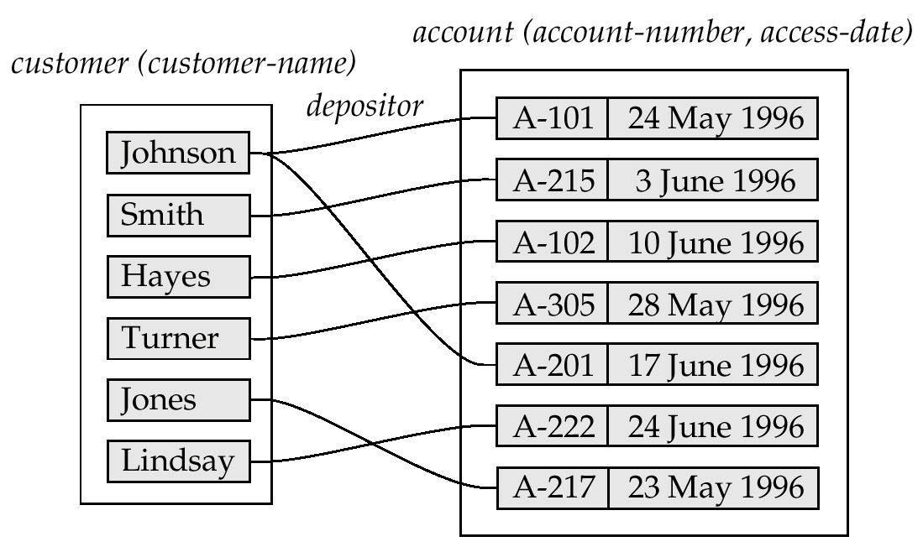

Mapping Cardinalities affect ER Design
Can make access-date an attribute of account, instead of a relationship attribute, if each account can have only one customer
  I.e., the relationship from account to customer is many to one, or equivalently, customer to account is one to many

Slide 21

E-R Diagrams
Rectangles represent entity sets.
Diamonds represent relationship sets.
Lines link attributes to entity sets and entity sets to relationship sets.
Ellipses represent attributes
  Double ellipses represent multivalued attributes.
  Dashed ellipses denote derived attributes.
Underline indicates primary key attributes

Slide 22

E-R Diagram With Composite, Multivalued, and Derived Attributes

Slide 23

Relationship Sets with Attributes

Slide 24

Roles
Entity sets of a relationship need not be distinct
The labels “manager” and “worker” are called roles; they specify how employee entities interact via the works-for relationship set.
Roles are indicated in E-R diagrams by labeling the lines that connect diamonds to rectangles.
Role labels are optional, and are used to clarify semantics of the relationship

Slide 25

Cardinality Constraints
Expressed by drawing a directed line (→), signifying “one,” or an undirected line (—), signifying “many,” between the relationship set and the entity set.
  E.g.: One-to-one relationship:
  A customer is associated with at most one loan via the relationship borrower
  A loan is associated with at most one customer via borrower

Slide 26
One-To-Many Relationship
In the one-to-many relationship a loan is associated with at most one customer via borrower, a customer is associated with several (including 0) loans via borrower

Slide 27
Many-To-One Relationships
In a many-to-one relationship a loan is associated with several (including 0) customers via borrower, a customer is associated with at most one loan via borrower

Slide 28
Many-To-Many Relationship
A customer is associated with several (possibly 0) loans via borrower
A loan is associated with several (possibly 0) customers via borrower

Slide 29

Participation of an Entity Set in a Relationship Set
Total participation (indicated by double line): every entity in the entity set participates in at least one relationship in the relationship set
  E.g. participation of loan in borrower is total
    every loan must have a customer associated to it via borrower
Partial participation: some entities may not participate in any relationship in the relationship set
  E.g. participation of customer in borrower is partial

Slide 30

Alternative Notation for Cardinality Limits
Cardinality limits can also express participation constraints
Associate pair of numbers (min,max) with each participating entity type in a relationship type
Min=0 means partial and min>0 means total.

Slide 31
Keys
A super key of an entity set is a set of one or more attributes whose values uniquely determine each entity.
A candidate key of an entity set is a minimal super key
  Customer-id is candidate key of customer
  account-number is candidate key of account
Although several candidate keys may exist, one of the candidate keys is selected to be the primary key.

Slide 32
Keys for Relationship Sets
The combination of primary keys of the participating entity sets forms a super key of a relationship set.
  (customer-id, account-number) is the super key of depositor
  NOTE: this means a pair of entity sets can have at most one relationship in a particular relationship set.
    E.g. if we wish to track all access-dates to each account by each customer, we cannot assume a relationship for each access. We can use a multivalued attribute though
  Must consider the mapping cardinality of the relationship set when deciding the candidate keys
  Need to consider semantics of relationship set in selecting the primary key in case of more than one candidate key

Slide 33

E-R Diagram with a Ternary Relationship

Slide 34
Weak Entity Sets
An entity set that doesn’t have key attribute of their own
The existence of a weak entity set depends on the existence of a identifying entity set
  it must relate to the identifying entity set via a one-to-many relationship set from the identifying to the weak entity set
  Identifying relationship depicted using a double diamond
The discriminator (partial key) of a WES is the set of attributes that distinguishes among all the entities of a WES
The primary key of a WES is formed by the PK of the strong entity set on which the WES is existence dependent, plus the weak entity set’s discriminator.

Slide 35

Weak Entity Sets …..
  We depict a weak entity set by double rectangles.
  We underline the discriminator of a weak entity set with a dashed line.
  payment-number – discriminator of the payment entity set
  Primary key for payment – (loan-number, payment-number)

Slide 36
Binary Vs. Non-Binary Relationships
Some relationships that appear to be non-binary may be better represented using binary relationships
  E.g. A ternary relationship parents, relating a child to his/her father and mother, is best replaced by two binary relationships, father and mother
    Using two binary relationships allows partial information (e.g. only mother being know)
  But there are some relationships that are naturally non-binary

Slide 37
Converting Non-Binary Relationships to Binary Form
In general, any non-binary relationship can be represented using binary relationships by creating an artificial entity set.
  Relationship R between entity sets A, B and C can be represented using a new entity set E, and three relationships R_{A}, R_{B} and R_{C} between E and A, B and C respectively
  For each relationship in R, we create a new entity in E, and relate it to the corresponding entities in A, B and C
  We need to create identifying attributes for instances of E
  Translating constraints may not be possible
  There may be instances in the translated schema that
  cannot correspond to any instance of R

Slide 38

Converting Non-Binary Relationships to Binary Form

Slide 39
Design Issues
Use of entity sets vs. attributes
  Choice mainly depends on the structure of the enterprise being modeled, and on the semantics associated with the attribute in question.
Use of entity sets vs. relationship sets
  Possible guideline is to designate a relationship set to describe an action that occurs between entities
Binary versus n-ary relationship sets
  Although it is possible to replace any nonbinary (n-ary, for n > 2) relationship set by a number of distinct binary relationship sets, a n-ary relationship set shows more clearly that several entities participate in a single relationship.
Placement of relationship attributes

